Slide 1
Verilog Netlist Enhancer
Alaa Mahmoud
Hadeel Mabrouk

Slide 2
Outline
Project Description
Approach
Dependencies
Design and Implementation
Building and Running
Limitations
Further Suggestions
References

Slide 3
Project Description
Implement a Verilog netlist modifier to enhance:
Maximum Fanout
Maximum Delay
By:
Sizing up cells with large fan-out
Cloning high fan-out cells
Adding buffers to high fan-out cells

Slide 4
Approach
Enhance Fanout by:
Cloning high fan-out cells
Adding buffers to high fan-out cells
Enhance Maximum Delay by:
Sizing up cells with large fan-out

Slide 5
Dependencies
Liberty Parser: for liberty file data extraction
Regular Expression Operations (regex): for verilog files parsing
NetworkX: for delay calculation and visual representation
Matplotlib: for graph drawing

Slide 6
Design and Implementation
Liberty Data Extraction Class
Verilog Netlist Class

Slide 7
Liberty Data Extraction Class
get_middle_capacitance() to return the value of the middle capacitance
get_pin_capacitance(cell_name, pin_name) to return the capacitance of a certain input pin for a certain cell
get_pin_delay( cell_name, pin_name, out_cap) to return the delay of a certain arc for a certain cell given the load capacitance

Slide 8
Verilog Netlist Class [Data Structures]
Netlist Dictionary Composed of the circuit instance as key, and its inputs, output, and load capacitance as values
Wires Dictionary Composed of the wire name as key, and its source and destinations as values
Netlist Directed Graph Composed of cells as nodes, and wires as edges

Slide 9
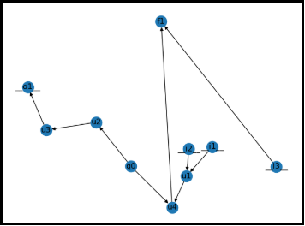
Verilog Netlist Class [Data Structures]
The Netlist Directed Graph

Slide 10
Verilog Netlist Class [Functions]
report_max_delay(): uses the longest path function of the DiGraph
report_no_of_cells_of_each_type()
max_fanout(): returns the maximum existing fanout of the circuit
buffer_all(desired_fanout)

Slide 11
Verilog Netlist Class [Functions]
clone_all(desired_fanout)
sizing_up(desired_delay): applies greedy sizing algorithm to decrease the delay of the critical path
nx.draw(get_graph()): visualizes the circuit as a directed graph
to_v_netlist(): prints the updated verilog netlist

Slide 12
Building and Running
First, run the utility main file by typing the command: python main.py
After running the main file, the program would ask to give the name of the verilog file as well as the library liberty file

Slide 13
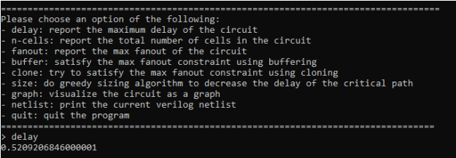
Building and Running
After entering the file names the interface will display the following:
And by entering any command, the program should apply the requested changes, and return the expected output

Slide 14
Limitations
No support for circuits having cells with multiple outputs
No support for delay calculation the rising and falling transitions of the inputs; it always chooses the larger transition delay
It assumes fixed input transition time, and fixed output capacitance
The list of the supported cells is fixed

Slide 15
Further Suggestions
Using optimization algorithms to enhance the delay and fanout
Enhancing the visualization of the circuit:
Making the nodes size and shape representative of its size and type
Highlighting violations in red
Making the thickness of the edge representative of its weight

Slide 16
References
“Liberty-Parser.” PyPI, https://pypi.org/project/liberty-parser/ .
“NetworkX.” PyPl, https://pypi.org/project/networkx/
“Re - Regular Expression Operations.” Re - Regular Expression Operations - Python 3.8.0 Documentation, https://docs.python.org/3/library/re.html .

Slide 17
Thank you!

